Slide 1
CS 0007: Introduction to Java
Lecture 2
Nathan Ong
University of Pittsburgh
September 6, 2016

Slide 2
Outline
Recap of last lecture
Java’s “Place of Residence”
Your First Program

Slide 3
Why Learn Java?
Widely used
Constantly updating and receiving support
Easily understood due to standardized and consistent syntax
Forces code readability
Virtual Machine isolates running code

Slide 4
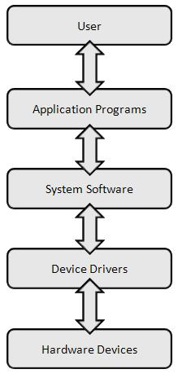
Software Layers
Applications: Software that interfaces with the user
System Software: Operating System (e.g. Windows, Mac OSX, Linux)
Device Drivers: Software to talk to non-computer devices (e.g. printers, webcams, etc.)
Source: http://cs.sru.edu/~mullins/cpsc100book/images/softwareLayers.jpg

Slide 5
What about java?

Slide 6
Virtual Machine
Java is run on a "Virtual Machine."
A Virtual Machine (VM) is an emulation of all of the components (hardware or software) necessary to run a certain piece of software.
It is technically an application.

Slide 7
Java Flowchart
COMPILER
Java Program
Java Bytecode
Java VM
Application Software Level

Slide 8
VM Pros and Cons
Pros:
Code and bytecode works independently from the platform (operating system) it was compiled on.
More secure due to runtime isolation.
Cons:
Generally slower runtime (than natively compiled languages like C++).
Arguably provides less fine-tuned usage of lower levels of software

Slide 9
Compiling and commenting
My First Program

Slide 10
Hello World!
A "Hello World" program is frequently a student's first program of any language.
Similar to learning "Hello" greetings in other languages.
Note: all code is CaSe SeNsItIvE

Slide 11
Hello World!
public class HelloWorld
{
public static void main(String[] args)
{
System.out.println("Hello World!");
}//end method main
}//End class HelloWorld

Slide 12
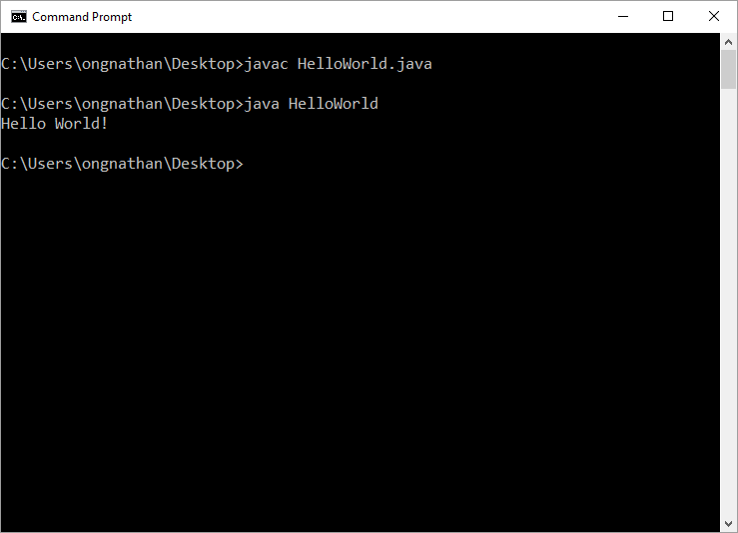
Compilation

Slide 13
Compiling
javac – compiling a java file
(javac FileName.java)
java – running a compiled java file
(java FileName)

Slide 14
Hello World!
public class HelloWorld
{
public static void main(String[] args)
{
System.out.println("Hello World!");
}//end method main
}//End class HelloWorld

Slide 15
System.out.println("Hello World!");
Statement
Ends with a semicolon (like a period in English)
Prints stuff
  Where to?
  What stuff?
To the console
Strings

Slide 16
Hello World v2
public class Hello
{
public static void main(String[] args)
{
System.out.println("My name is Nathan Ong! YAAAAYYYY LALALALA RANDOM TYPING");
}//end method main
}//End class Hello
What is the output?

Slide 17
String
Characters in between quotation marks
Some valid Strings
  "Hi"
  "#&^@!*(QQQQQQQQ"
What if we want quotation marks in the String?

Slide 18
\
Escape character \ tells the computer that the next character should not be taken literally
  \"
  Tab? \t
  New line? \n
  Slash? \\
  "Java said, "OMG SYNTAX ERROR""
How do we make the line above a valid String?
Notes:
Needs to be moved

Slide 19
Hello World v2
public class Hello
{
public static void main(String[] args)
{
System.out.println("My name is Nathan Ong! YAAAAYYYY LALALALA RANDOM TYPING");
}//end method main
}//End class Hello
What if I want to use my name in another print statement?

Slide 20
Recycling
What if I want to use the string somewhere else?
I'm so lazy, I don't want to type in my name when printing it out all the time.
String name = "Nathan Ong";
Now I can call name wherever I want (not really)!
-->Variables<--

Slide 21
String name = "Nathan Ong";

Slide 22
String name = "Nathan Ong";
Type

Slide 23
String name = "Nathan Ong";

Slide 24
String name = "Nathan Ong";
value

Slide 25
To Declare a Variable:
Type name = value;

Slide 26
To Use a Variable: name

Slide 27
Naming
The name of a variable (and other things) are called identifiers.
There are some rules regarding valid identifiers, and further conventions that you should follow.

Slide 28
Valid Identifiers
You must have at least one character in the name
You can only use alphanumeric characters (letters and numbers), underscores (_), and dollar signs ($) in the name
You CANNOT use a number as the first character.
You CANNOT use reserved Java keywords.

Slide 29
Reserved Java Keywords
boolean do int static
break double long super
byte else new switch
case final package this
catch finally private throw
char float protected throws
class for public try
continue if return void
default import short while

Slide 30
Conventional Naming
Variables and functions: lowerCamelCase
  First word starts with a lowercase letter, subsequent words have uppercase first letters
Class names: UpperCamelCase
  All words have uppercase first letters
Never use dollar signs or underscores

Slide 31
Hello World v3
public class Name
{
public static void main(String[] args)
{
String name = "Nathan Ong";
System.out.println(name);
System.out.println(" is ");
System.out.println(name);
}//end method main
}//End class Name
What is the output?

Slide 32
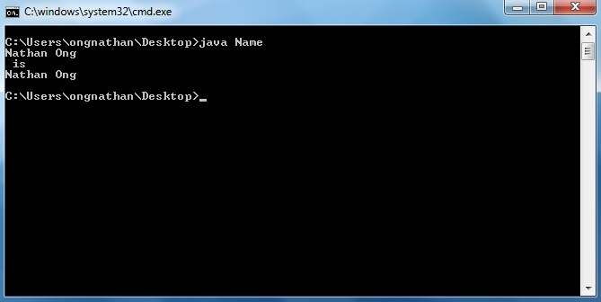
Oh I changed my name…Nathan Ong is no longer Nathan Ong…What am I going to do?

Slide 33
What can we do with it?
public class Name
{
public static void main(String[] args)
{
String name = "Nathan Ong";
System.out.println(name);
System.out.println(" is ");
String name = "Brandon Ong";
System.out.println(name);
}//end method main
}//End class Name
Can we do this?
No, because we re-declared a variable!

Slide 34
Declaring a new variable:
Type name = value;
Changing the old variable: name = newValue;

Slide 35
What can we do with it?
public class Name
{
public static void main(String[] args)
{
String name = "Nathan Ong";
System.out.println(name);
System.out.println(" is ");
name = "Brandon Ong";
System.out.println(name);
}//end method main
}//End class Name
What is the output?

Slide 36
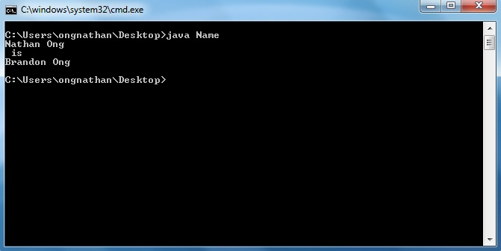
Okay so I'm not really changing my name.
Regardless, the output is really annoying.
How do we put it all in one line?

Slide 37
What can we do with it?
public class Name
{
public static void main(String[] args)
{
String name = "Nathan Ong";
System.out.print(name);
System.out.print(" is ");
System.out.println(name);
}//end method main
}//End class Name
Use print instead. No new line added.
Saying print print print is kind of annoying…

Slide 38
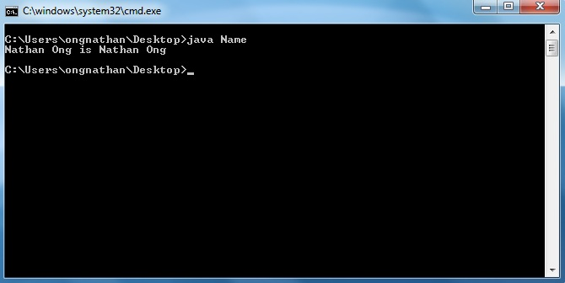
*cough* \n *cough*
Ahhhhh, that's better.
But just for fun, how do we get it back to the multiple-line version using the print statements instead of println?

Slide 39
What can we do with it?
public class Name
{
public static void main(String[] args)
{
String name = "Nathan Ong";
System.out.print(name);
System.out.print("\n is \n");
System.out.println(name);
}//end method main
}//End class Name
Getting the same output from before with only print. But we don't like that, so we'll take that out
Saying print print print is kind of annoying…

Slide 40
What can we do with it?
public class Name
{
public static void main(String[] args)
{
String name = "Nathan Ong";
System.out.println(name + " is " + name);
}//end method main
}//End class Name
Using + with Strings is called concatenation
(Note: there's no such thing as – for Strings)

Slide 41
What can we do with it?
public class Name
{
public static void main(String[] args)
{
String name = "Nathan Ong";
System.out.println(name + " is " + name);
}//end method main
}//End class Name
Concatenation does not add spaces automatically.

Slide 42
Nicknames
System.out.println(name +
" is " + name);
Seems useful, like if someone had a nickname
System.out.println(nickName +
" is " + name);
But I don't have one…how do we make it so it doesn't matter?

Slide 43
Nicknames
public class Name
{
public static void main(String[] args)
{
String name = "Nathan Ong";
String nickName = name;
System.out.println(nickName + " is " + name);
}//end method main
}//End class Name
Oh so we can make nickName the exact same thing as name without having to type everything again!
What is the output?

Slide 44
Same thing

Slide 45
Comments
public class Name
{
public static void main(String[] args)
{
String name = "Nathan Ong";
String nickName = name;
System.out.println(nickName + " is " + name);
}//end method main
}//End class Name

Slide 46
Commenting
You must comment every line of useful code.
Don't forget the //
If you need a block of comments, use /* */
Everything in between is commented out
Careful about nested comments…
/* This /* Comment Ends */ Here???*/

Slide 47
Line-by-Line Commenting
//The file name
^Bad comment
//Prints out statistics for
//Nathan Ong
^Good Comment
public class Name

Slide 48
Line-by-Line Commenting
//The main method
^Bad comment
//The program begins here
^Good Comment
public static void main(String[] args)

Slide 49
Line-by-Line Commenting
//A String
^Bad comment
//The first name held in a
//String
^Good Comment
String name = "Nathan";

Slide 50
Line-by-Line Commenting
//Prints out stuff
^Bad comment
//Prints out the names
^Okay comment
/*Prints the nickname and links it to the original name.*/
^Good comment
System.out.println(nickName +
" is " + name);

Slide 51
Recap
Hello World!
System.out.println (and print)
Strings and String concatenation
Compiling and running
Variables
Type name = value;
name = newValue;
Commenting

